Slide 1
SISC Small Group Kickoff
AIRA

Slide 2
Agenda
Introductions
Small Group Overview
Nathan
Topic Introduction
Champion
Discussion
Begin conversation on scope
Set dates for next meetings & virtual day
Initial group assignments

Slide 3
Small Group Overview
Nathan Bunker

Slide 4
SISC Small Work Groups
Tightly scoped to a specific topic
Time limited, the group meets for four weeks
Interest is driven by community
Three or more organizations/interests, including IIS
A champion willing to spearhead effort
All group members committed to provide specific help to group
Proposed guidance is brought back to SISC for discussion

Slide 5
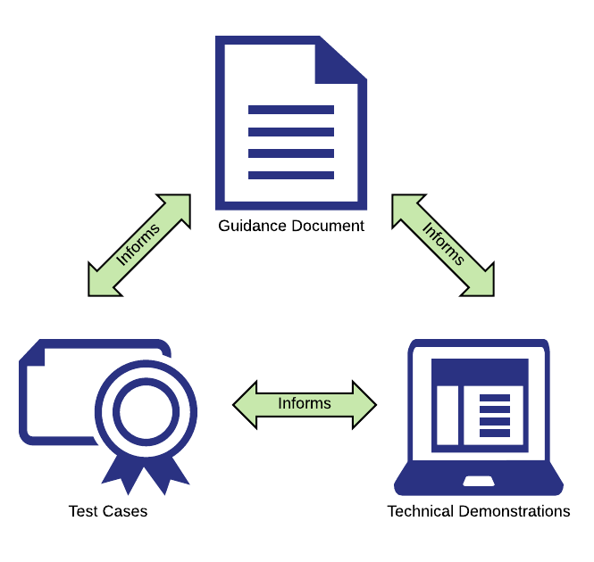
What will be created?
Guidance document
Specific technical guidance
Proposal only, SISC will review
Test cases
Testable scenarios that verify adherence to guidance
Technical demonstrations
Prove workability of guidance
Provide reference implementation

Slide 6
Project Intensity
Project Setup
Orientation and Discussion
Work Together
Work Finalized

Slide 7
Virtual Meeting
25 hour period where the entire group meets
From the afternoon until morning of the next day
Allows for team to operate on different timezones
Team needs to be committed to removing conflicting meetings
Bring group together in the afternoon of the first day
Split into smaller working groups to focus on deliverables
Come back together as needed
Bring group back together at the end on the second day
Show accomplishments, determine status of deliverables

Slide 8
Group Tools
GitHub
Project board & task tracking
Wiki page with team resources and information
File sharing
Slack
Uber Conference

Slide 9

Setting Scope
Technical work group
Not policy work group
We can’t say what ought to be or what will be
Technical Toolbox
Prepare for different scenarios
Need guidance that can be implemented quickly

Slide 10
Thank You!

Slide 11
Topic Introduction
Jane Lammers

Slide 12
Discussion
Jane Lammers

Slide 13
Scope for Small Group
In Scope
ERR-5: Adding new codes to list
Minor changes to existing codes possible
Meta Information
Cross linking with Data Validation Guide - Link to specific section in a guide
Flag items that are clinically possible so should not ever be hard errors
Actor/Action – could get some feedback from IIP
Look at Actor terms/types
Out of Scope
Severity
ERR-3
In or Out ?
ERR-7 Diagnostic Information
ERR-8
ERR-9
Notes:
The champion should propose to the group an initial scope. The group should discuss, but this does not have to be finalized in the Kick Off meeting. If the discussion lasts for more than 10 minutes then the discussion will continue on the first call of the group. It usually takes two meetings to get the scope set for sure.

Slide 14
Meeting Dates
Two or three meetings in the next two weeks
Ask on the group and set times now
Virtual Day
Choose an afternoon and morning of two days to work together
Focus on a day two or three weeks in the future
Set starting time/ending time
E.g. Tuesday 2pm ET until Wednesday 3pm ET
Group meets at 2pm on Tuesday, then breaks into small groups to do work
Group reconvenes at 2pm on Wednesday to conclude the effort
Ask all members to clear their calendar now

